Slide 1


MECHATRONICS ENGINEERING
STRENGTH OF MATERIALS PROJECT
KAAN ÖĞRÜK
BARIŞ LEVENTGELEN
HALİL KÜRŞAT AKKUŞ
GÜL KADER GÖGÜS
EMRAH BAYRAM
UMUR BATUHAN ÖZMEN

Slide 2
DETAILS OF THE PROJECT
Main Problem: The aim of this project is to perform tensile testing by using pasta. In this way, the tensile and strain properties of the materials will be physically observed.
Method: In the project, a stress will be created in direct proportion to the force applied to the pasta. The resulting stress and strain will be calculated thanks to the force detected by the sensor. With the data obtained, a real-time graph will be created.

Slide 3
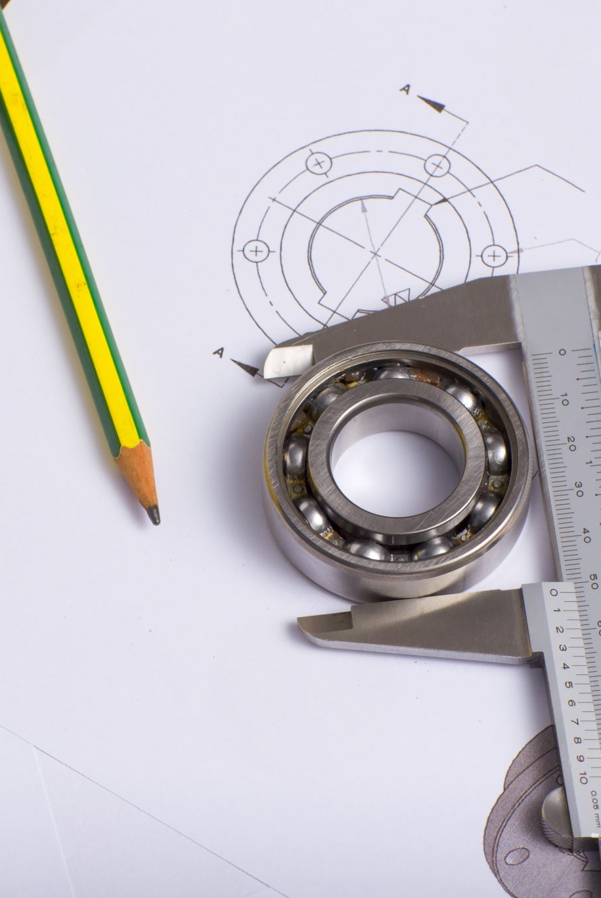
MECHANICAL DESIGN OF THE PROJECT
The mechanical part of the traction system basically consists of 8 separate parts.
MAIN BODY
HOLDER PART
MOVER PART
FASTENERS
LINEAR BEARINGS
SLIDER
THREADED ROD
SENSOR HOUSING

Slide 4
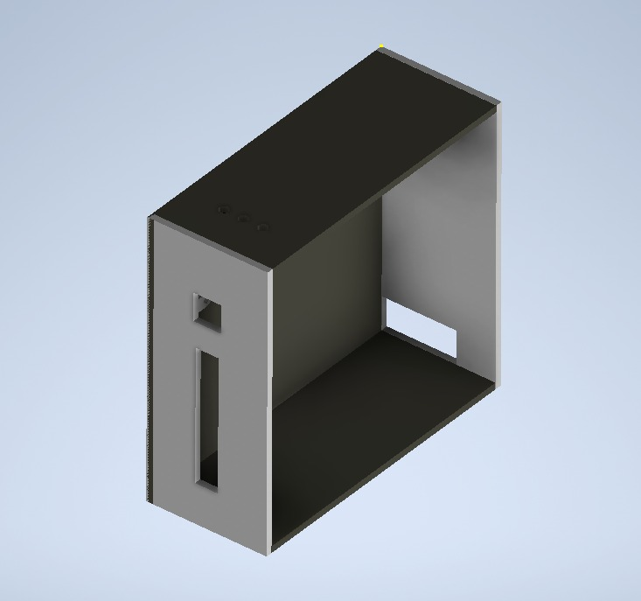
MAIN BODY
The main body of the mechanism consists of the computer case to save cost and production time. In addition, with the help of the compartment on the back of the computer case, it provides a more ergonomic placement of the components of the electrical and software sections

Slide 5
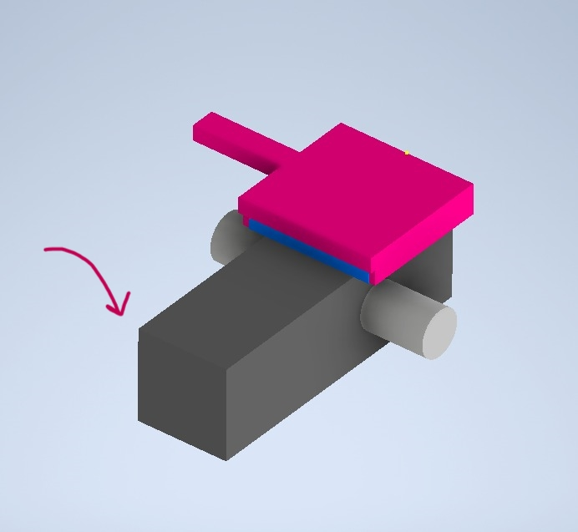
HOLDER PART
The purpose of the part is to transmit the vertically downward applied force to the force sensor of equal magnitude but opposite direction. It is aimed to be fixed to the main body with a pin in the middle and rotate 360 degrees only in the direction of the applied torque.

Slide 6
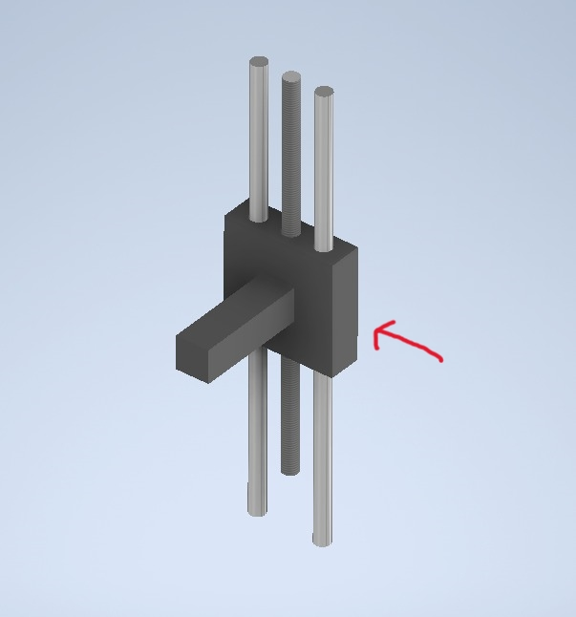
MOVER PART
This part is the part that the motor will move up or down on the vertical axis by applying force. Its stability and rigidity are of great importance. It is a critical part of the mechanism.

Slide 7
FASTENERS (Under Development)
These are the parts that will hold the object to be pulled without slipping.

Slide 8
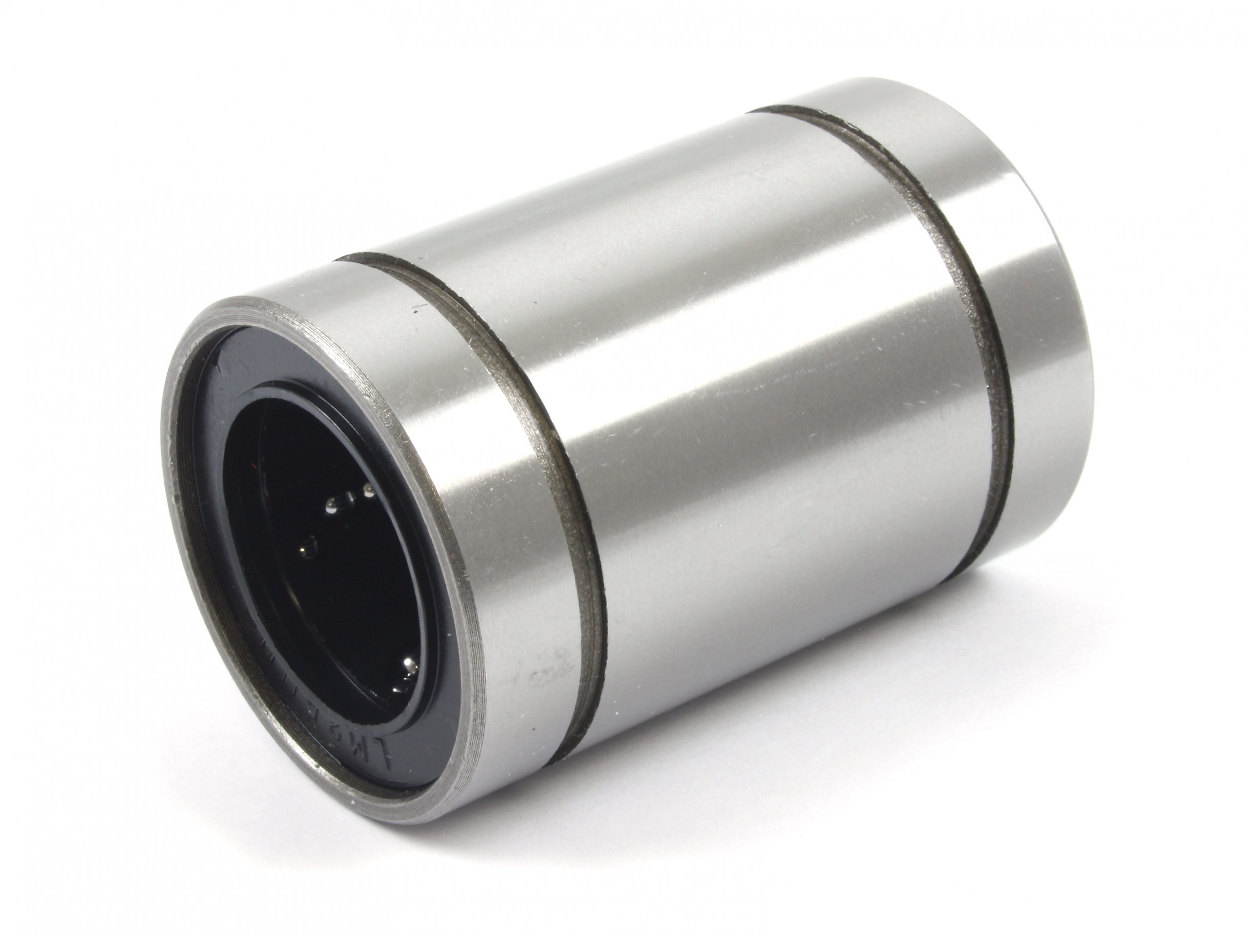
LINEAR BEARING
The purpose of use is to facilitate the movement of the mover part, which will move directly with the sliders on the vertical axis. It is aimed to minimize friction with this part to be added by purchasing from the market.

Slide 9
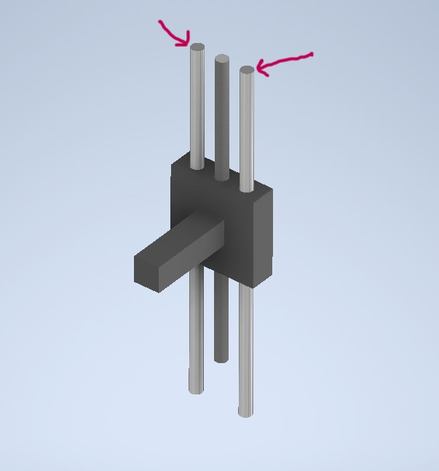
SLIDERS
These are the parts that will ensure that the holding part does not move on the horizontal axis during the movement and under a certain force and that the movement will take place more stable. These are the parts to be purchased from the market with specific dimensions.

Slide 10
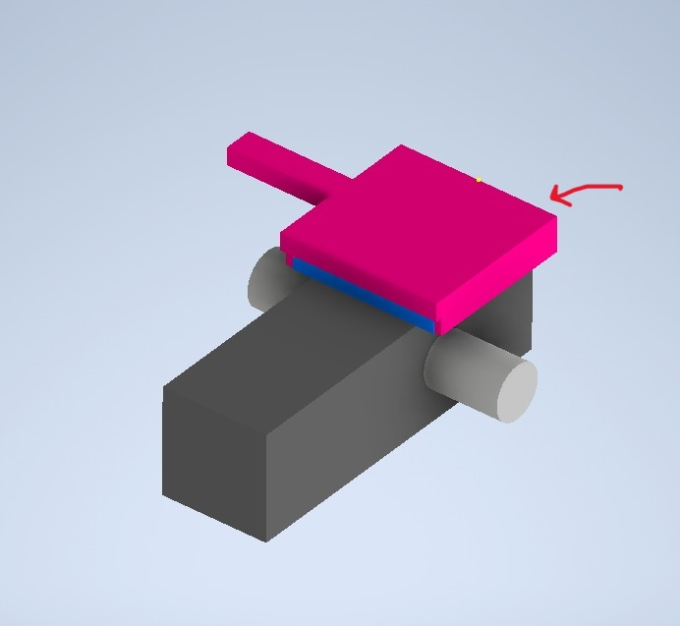
SENSOR HOUSING
It was designed to expand the field of force exerted on the sensor. Because the spread of the force acting on the sensor to the entire active region of the sensor increases the accuracy and precision of the measurement.

Slide 11
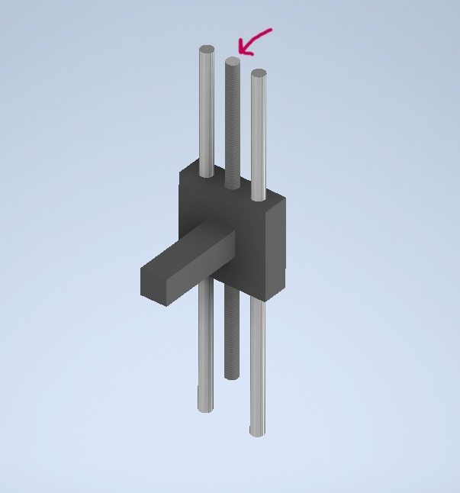
Threaded Rod
It is the gear rod that the motor rotates on the horizontal axis. Since it passes through the threaded hole in the Mover Part, it moves the mover part on the vertical axis with the rotation effect.

Slide 12
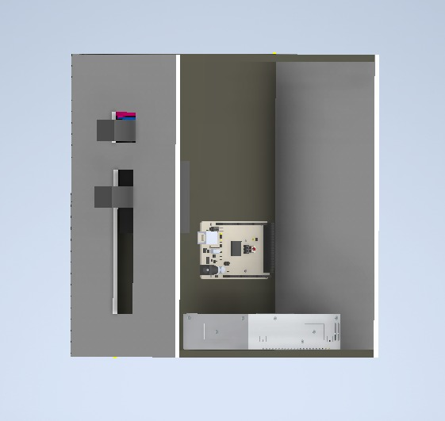
GENERAL VIEW

Slide 13

CALCULATIONS

Slide 14
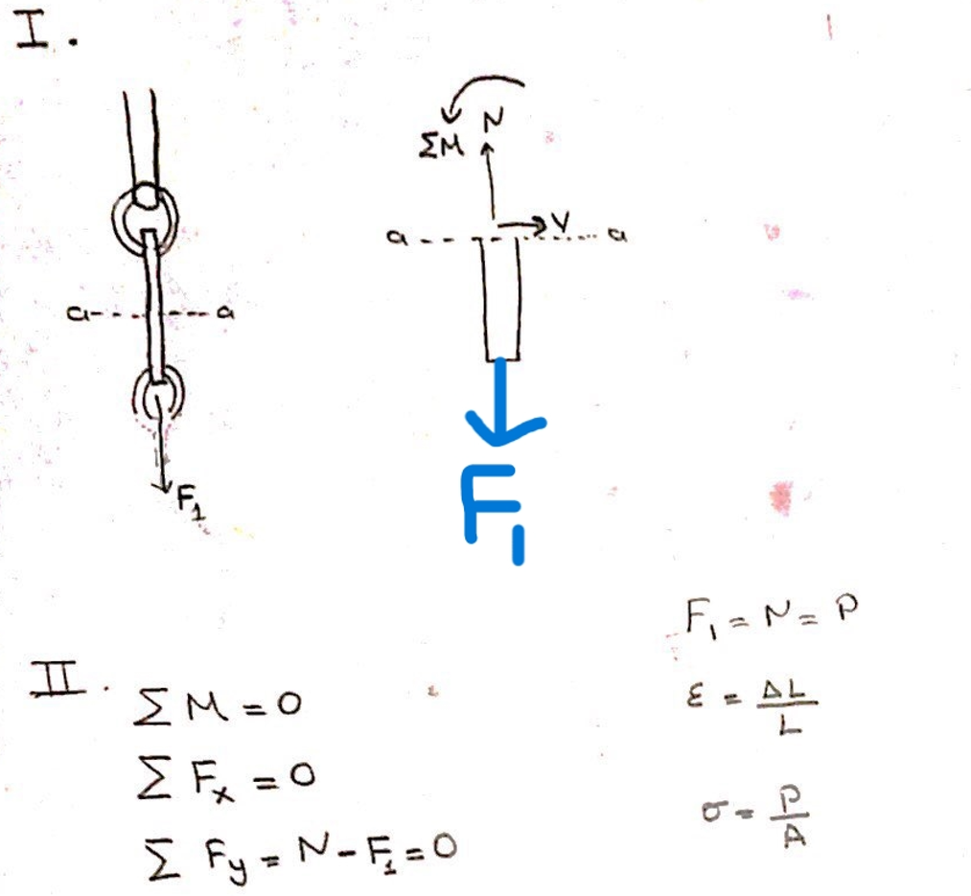
Strength of Pasta

Slide 15
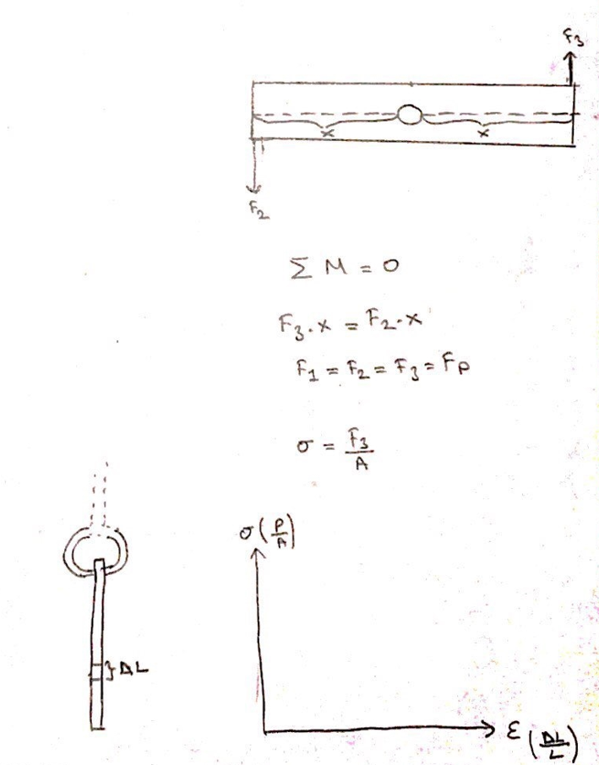
CALCULATION OF HOLDER PART

Slide 16

SOFTWARE PART OF THE PROJECT

Slide 17
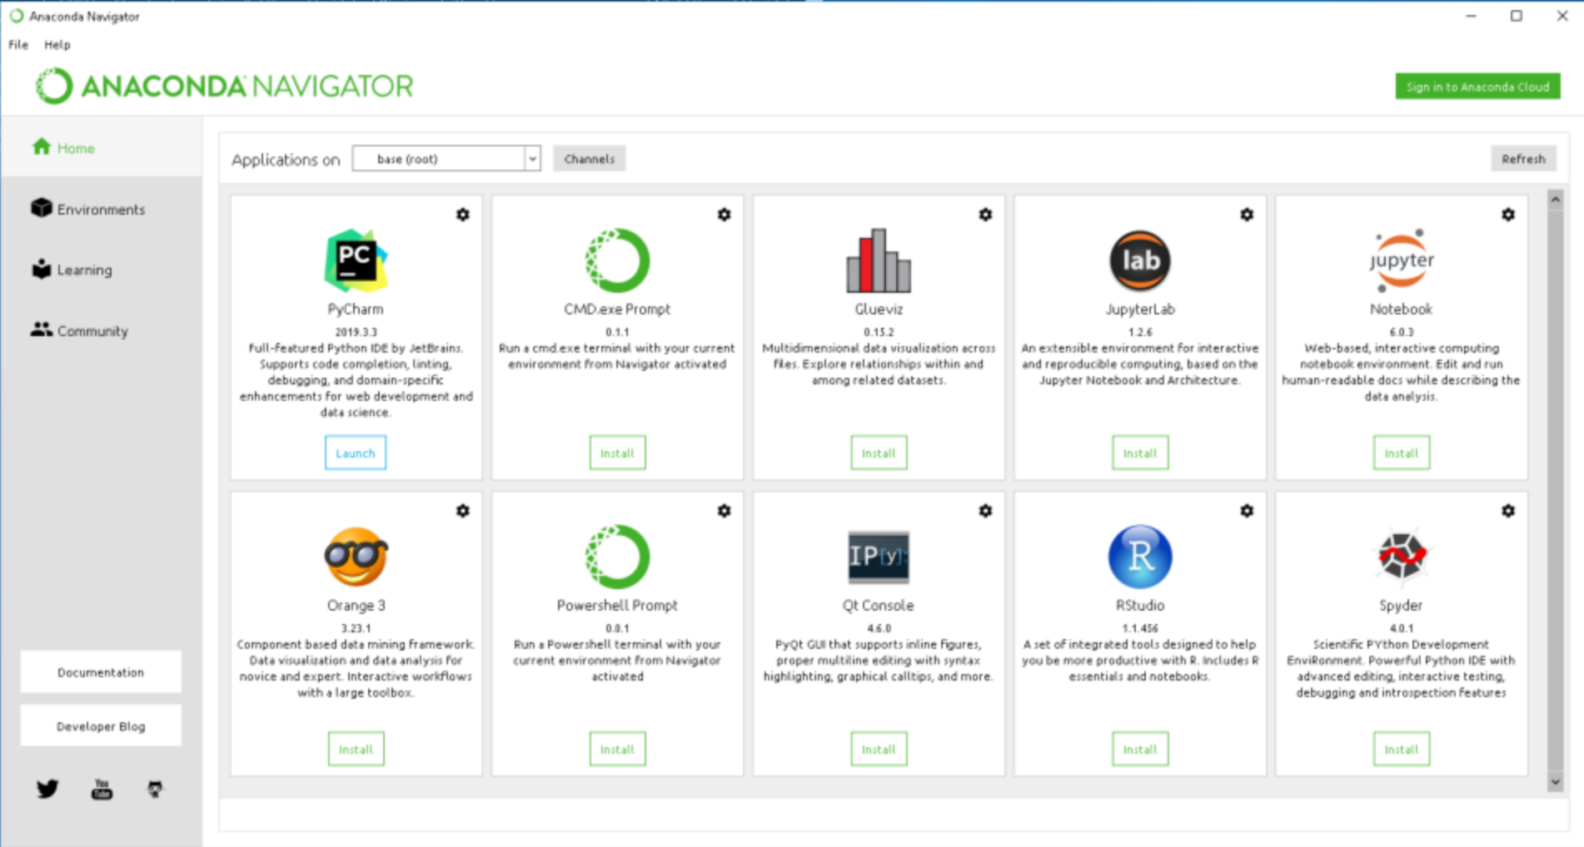

SOFTWARE APPLICATIONS
Anaconda Software
Anaconda is a Python-based data processing and scientific computing platform. It has built-in many very useful third-party libraries. Installing Anaconda is equivalent to automatically installing Python and some commonly used libraries such as Numpy, Pandas, Scrip, and Matplotlib, so it makes the installation so much easier than regular Python installation.

Slide 18
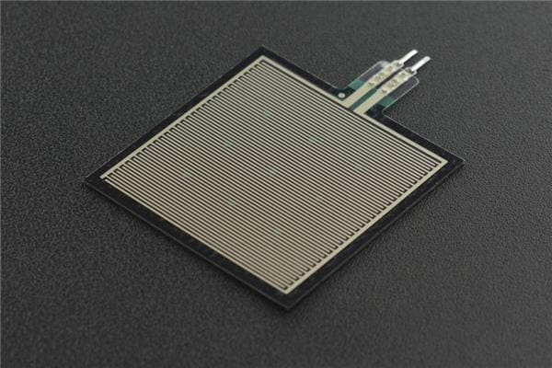
SENSOR CALIBRATION
The first problem we encountered was that there was no linear increase in the values given by the sensor we received to use in the mechanism.
For that reason, we decided to solve this problem by machine learning.

Slide 19
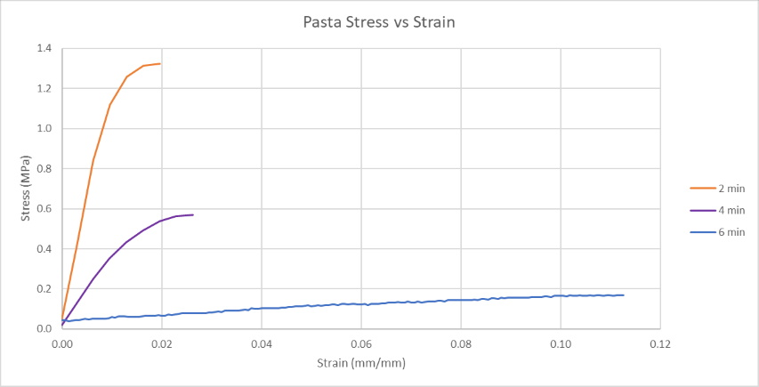
REAL-TIME PLOTTING
In order to draw the Stress-Strain graph vividly, we will create a code that automatically maps the data on the sensor and transfers it to the system that will draw the graph

Slide 20

ELECTRICAL PART OF THE PROJECT

Slide 21
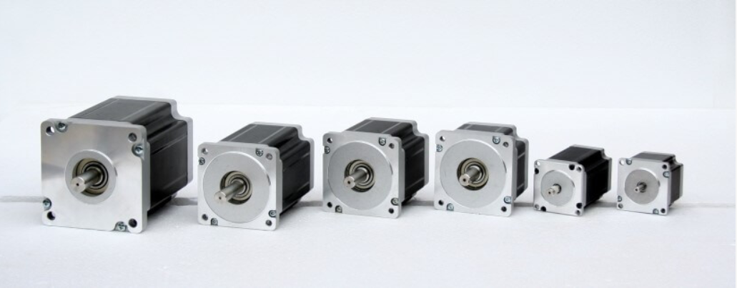
Stepper Motor
The stepper motor, which has a 200-step structure, must take 200 steps to turn 360 degrees, that is, a full revolution. 360/200=1.8 degrees. In other words, with each step, the motor makes a 1.8-degree angle and completes 360 degrees in a full turn.

Slide 22
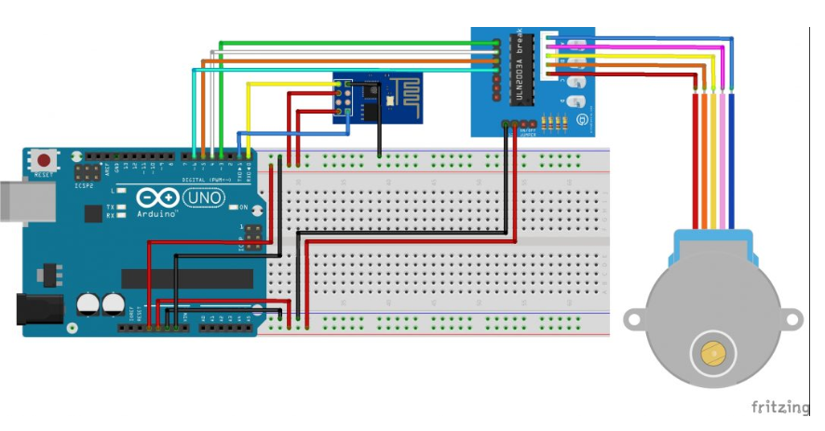
Connecting With Arduino
It is a pretty simple to set a stepper motor by using arduino. We need;
1x Arduino
1x Stepper Motor
1x Stepper Motor Driver
6x Female and Male Jumper Cable

Slide 23
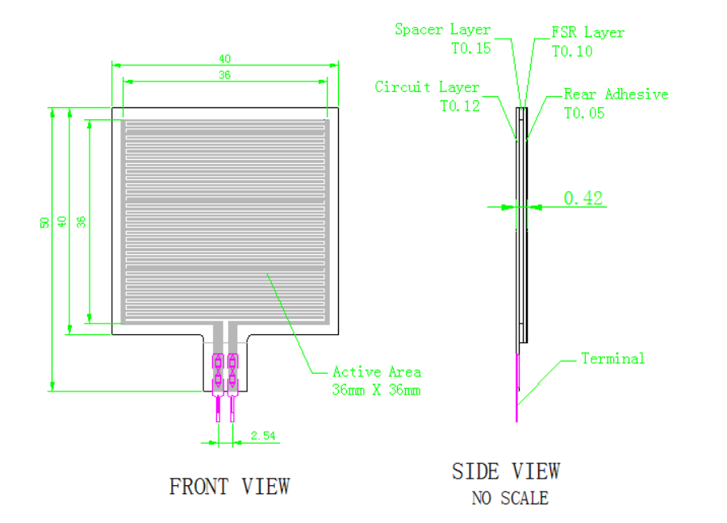
RP-S40 Pressure Sensor
Force Sensitive Resistor are resistive sensor exhibiting vary resistance that responds to force applied to the sensing area. As force on the sensor is increased, resistance is decreased. For the single-zone sensors, as the sensor is a Two-terminal device that can essentially be treated as a variable resistor whose value is controlled by applied force, and a switch whose threshold is controlled by applied force and setting up.

Slide 24
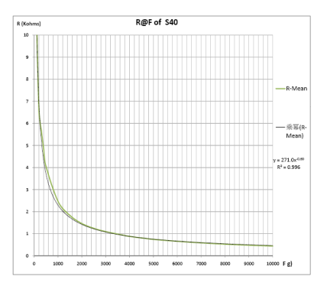
R(kΩ) vs. F(g) Graph
The plot on the right shows an example response resistance curve, when the sensor actuated by a force curve tester.

Slide 25
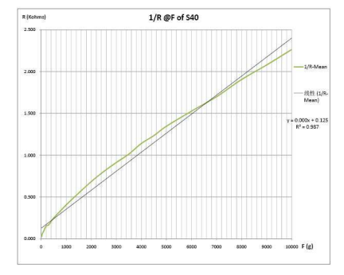
1/R (1/kΩ) vs F(g)
The plot on the right shows a near-linear curve treated by the axis value log10. We will get the force by approximating this graph.

Slide 26


Slide 27

THANK YOU FOR LISTENING

